Slide 1
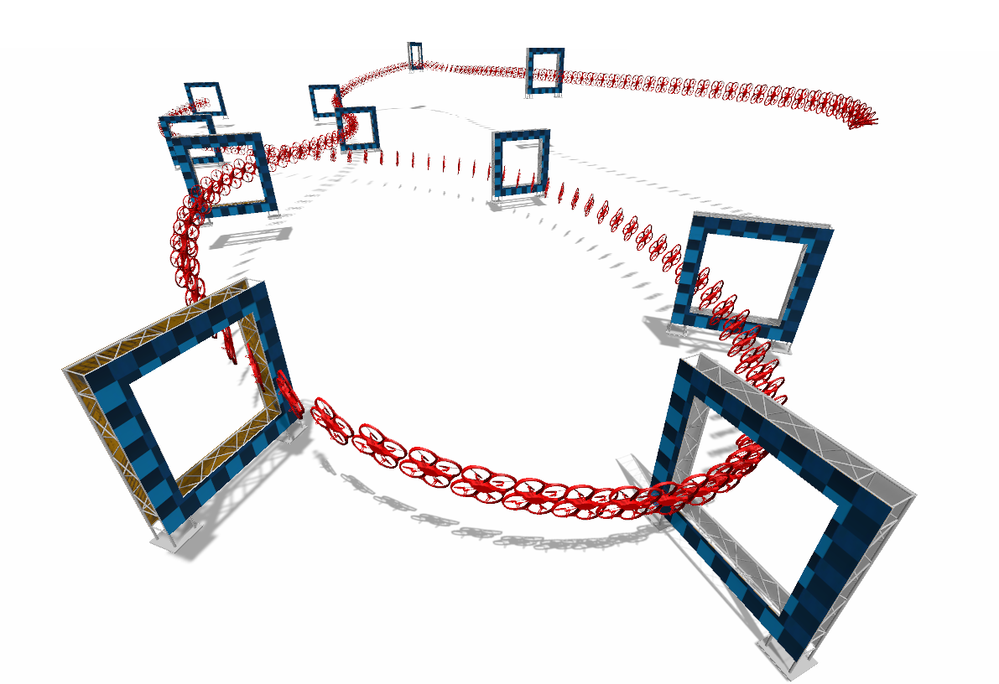
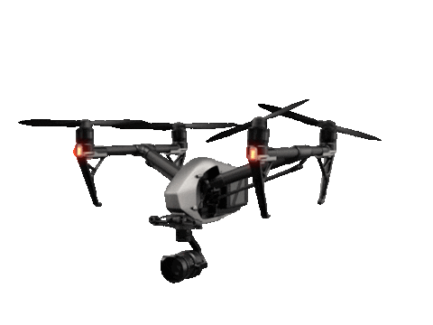
RBE 595 - Reinforcement Learning
Vision Based Quadrotor Obstacle Avoidance
Uday Girish Mardana Jeel Chatrola
Instructor: Navid Dadkhah Tehrani

Slide 2
Objective
To perform end-to-end motion planning for a quadrotor, emphasizing the use of raw depth images for reinforcement learning.
We deploy a single, reliable module using deep reinforcement learning. A quad-rotor is deployed for navigation in a partially known environment.
A straight path to the goal position is known without any obstacle location information on it.
The quad-rotor is supposed to generate local motion plans using this information and its online sensory data for safe and quick navigation.

Slide 3
Approach
State - Depth image ( 84x84 ) + position ( 3x1 ).
Action - Respective move at each time step following some policy to increase rewards ( among 9 motion primitives ).
Reward - Signal which assesses the quality of the agent’s actions.
Agent (DQN) - Trained which takes a raw depth image and relative position information as its input, and yields a motion primitive selection as its output We want to Estimate Action-Value Function Q(s,a).

Slide 4
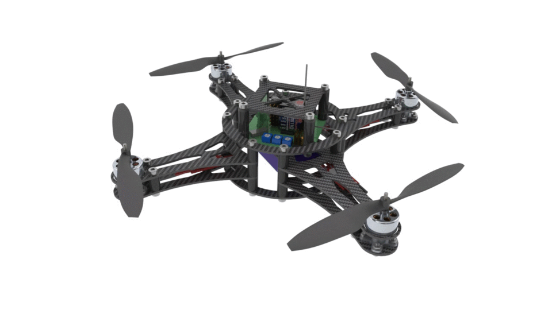
Motion Primitives
FW UP
UP
FW RIGHT
RIGHT
LEFT
FW DOWN
FW LEFT
DOWN
Forward (FW)

Slide 5
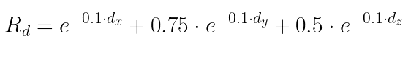
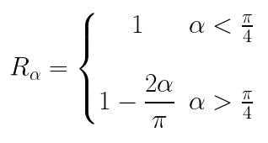
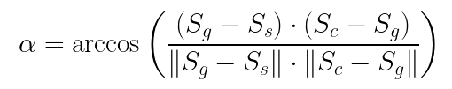
Reward Design
Distance Reward (R_{d}): It encourages the drone to move closer to the goal by providing a higher reward for smaller distances. d - distance between of current state to goal state
Angle Reward (R_{𝛼}) : This is the reward based on the angle between the current position and the start position with respect to the goal. It encourages the drone to move close to global path that reduces this angle, effectively guiding reducing deviation from path. G = Goal State, S = Start State, C = Current State.

Slide 6
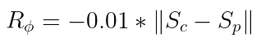
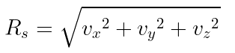
Continued …
Collision Penalty (R_{cp}): It discourages the drone from colliding with obstacles by providing a significant penalty for collisions.
Smoothness Penalty (R_{ɸ}) : It discourages abrupt changes in the drone's position, promoting a smoother and more stable flight.
Speed Reward (R_{s}) : It encourages the drone to maintain a higher speed, which could help it reach the goal faster.

Slide 7
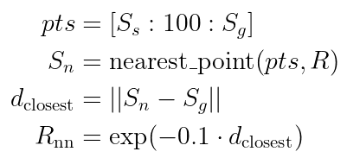
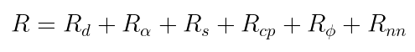
Continued …
Nearest Neighbours Reward (R_{nn}): This is the reward based on the nearest neighbors on the global path to the current. It encourages the drone to stay close to the global path by providing a higher reward for being closer to the points on this path.
Total Reward R :

Slide 8
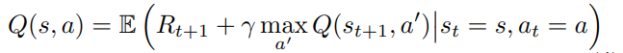
Algorithmic Details
Main aim of Reinforcement learning algorithm for this task is to estimate the action-value function Q(s,a).
For this project we select Deep-Q-Network for learning the complex action value function.
Notation:
s_{t} is current state of agent at time t.
s_{t+1} state of agent at time t+1.
a_{t} is action taken at time t.
R_{t+1} is reward agent obtains at time t+1 after taking action a_{t}.
ℽ is discount factor.

Slide 9
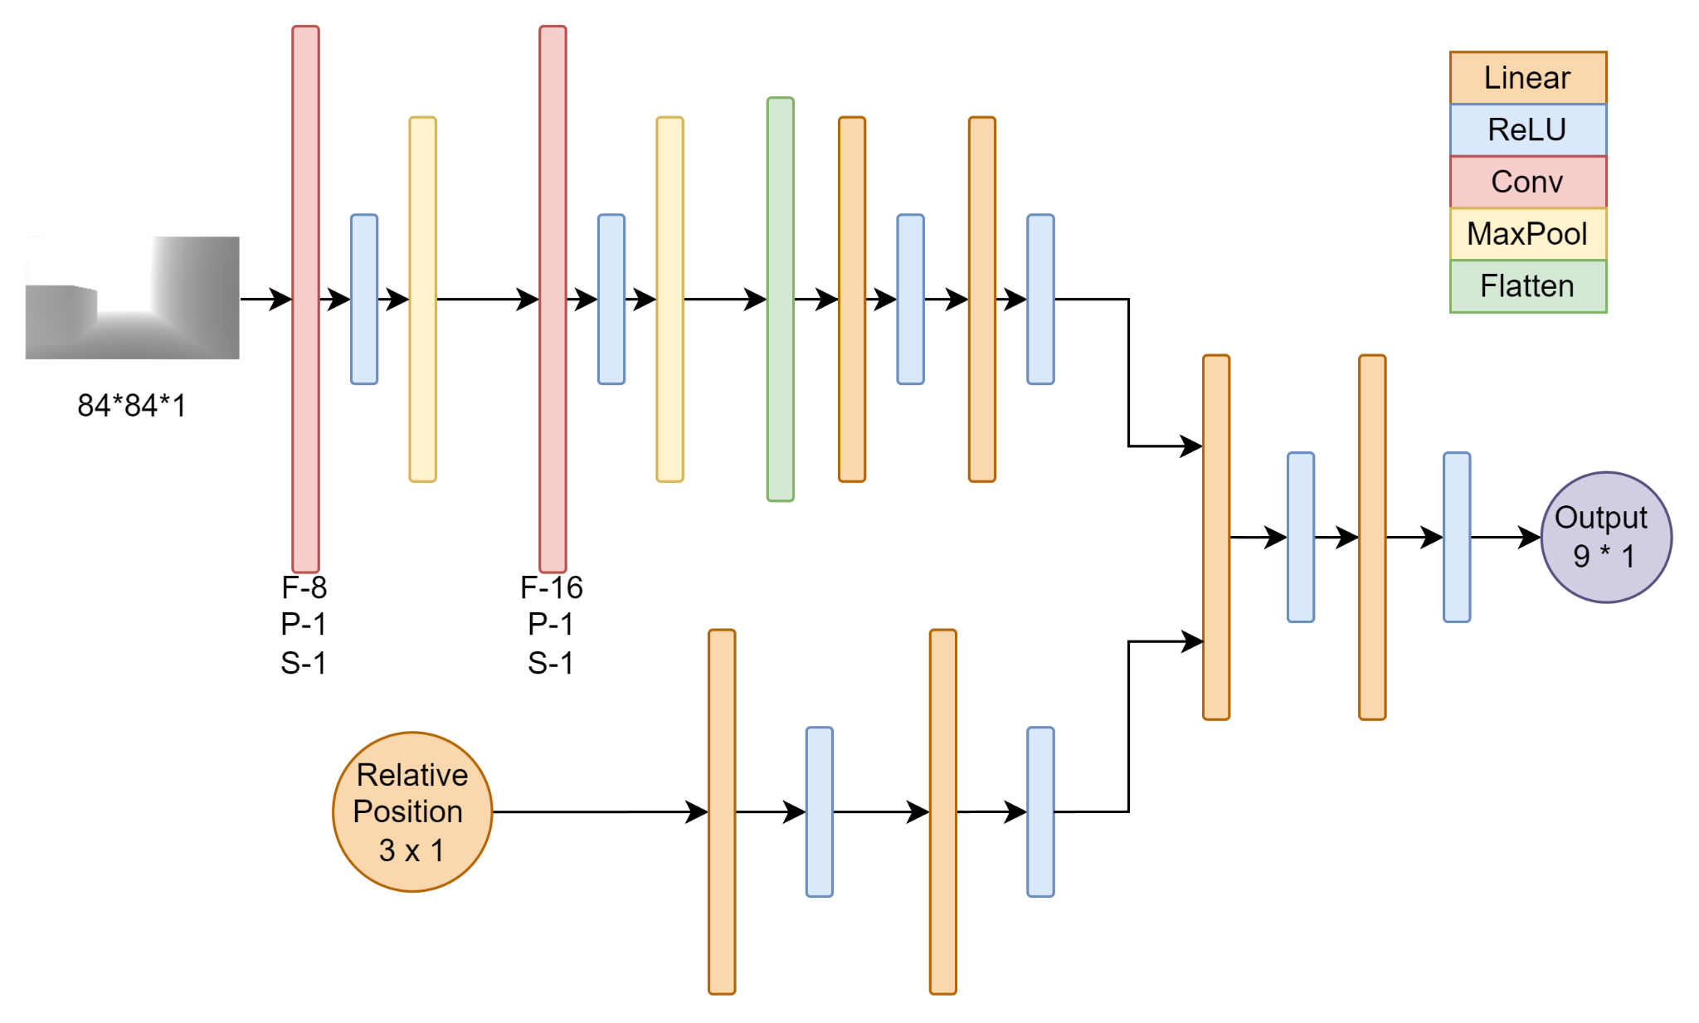
Network Architecture (Custom Multi Input)

Slide 10
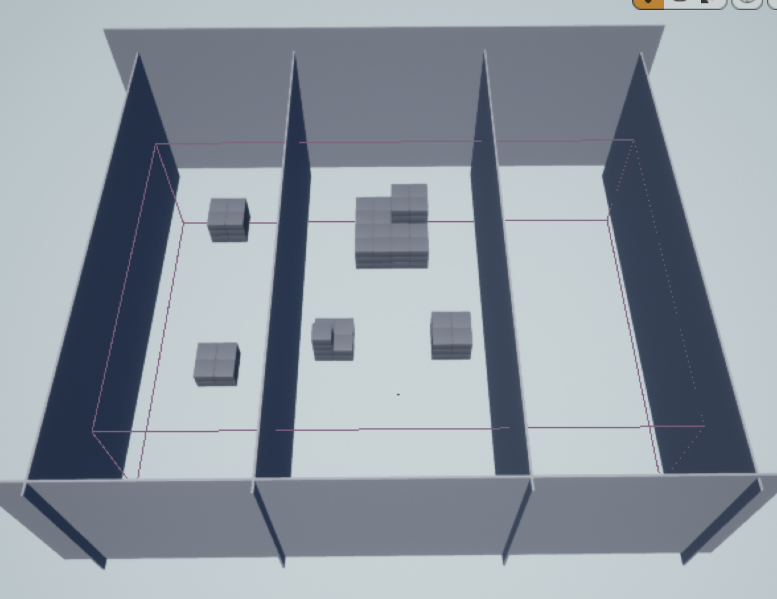
Experimental Setup (Custom)
Complex Multi Obstacle Env
Test on both 1 & 2 Obstacle Environments
No Obstacle Env

Slide 11
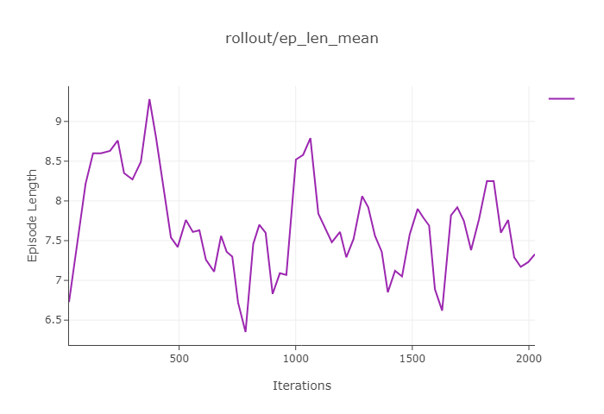
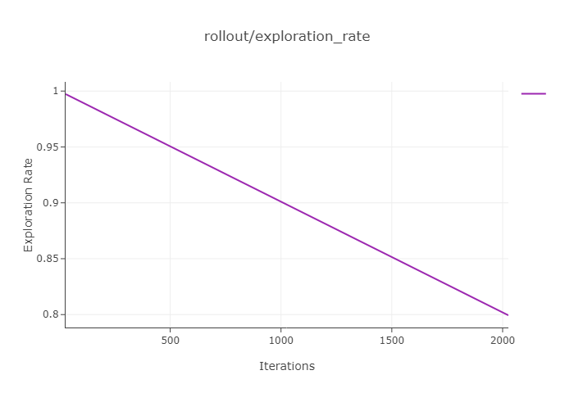
Experiments
Episode Exploration Rate
Episode Length Mean

Slide 12
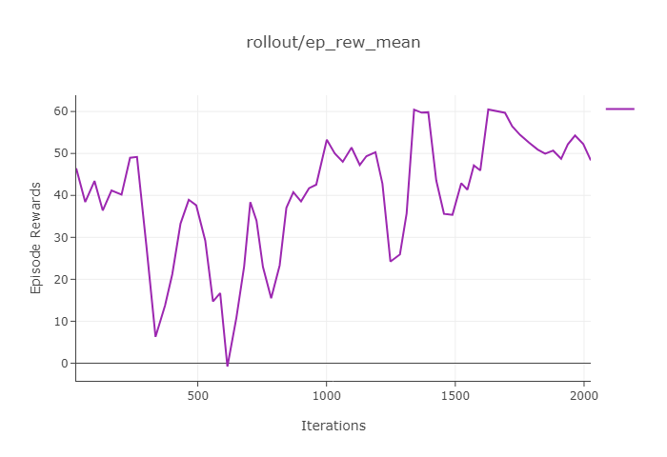
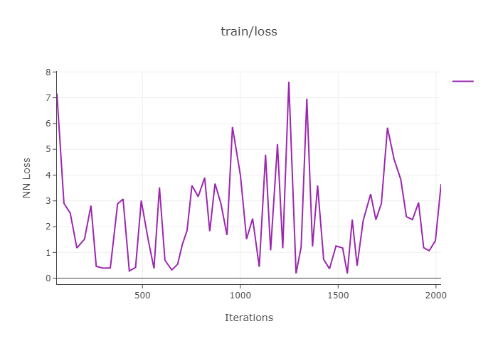
Experiments
Episode Reward Plot
Episode Loss

Slide 13
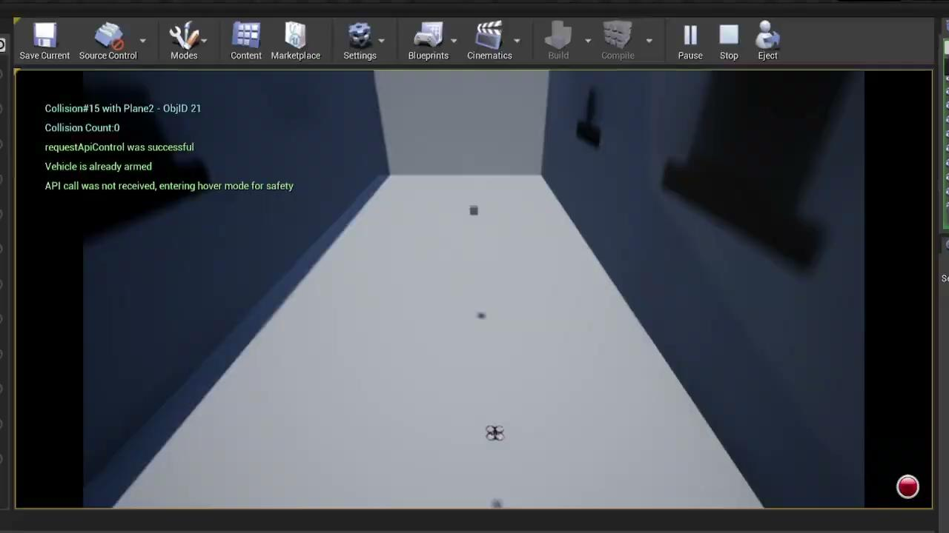
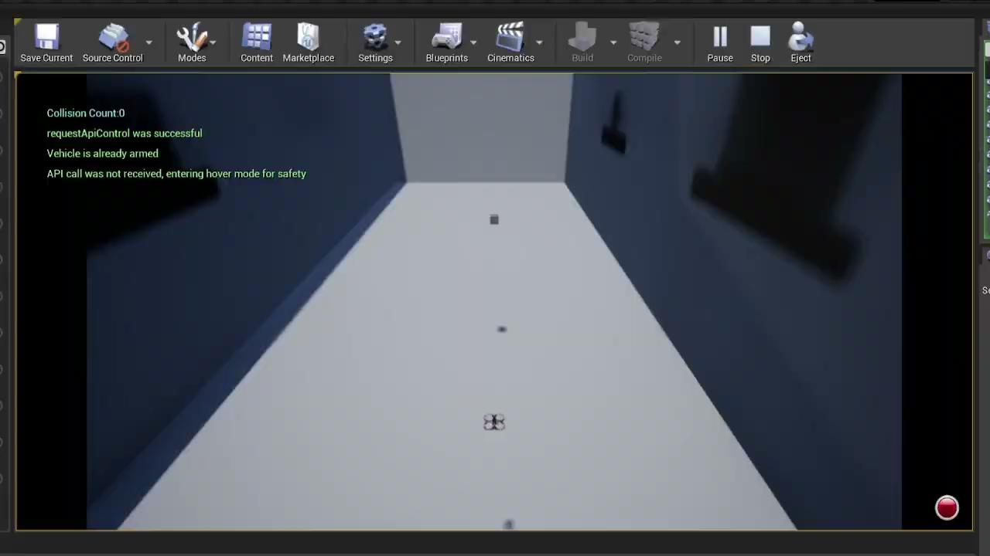
Results - No Obstacle
Partial Successful - Initial iterations (Drift at the End)
Successful Task Completion

Slide 14
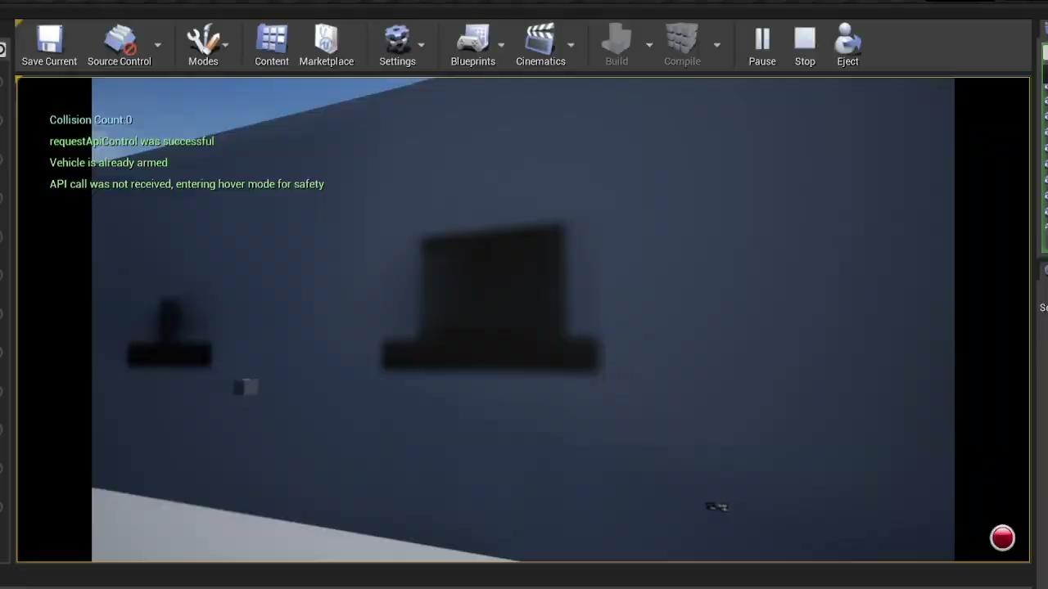
Results - No Obstacle (Side View)
Successful Task Completion - Side View

Slide 15
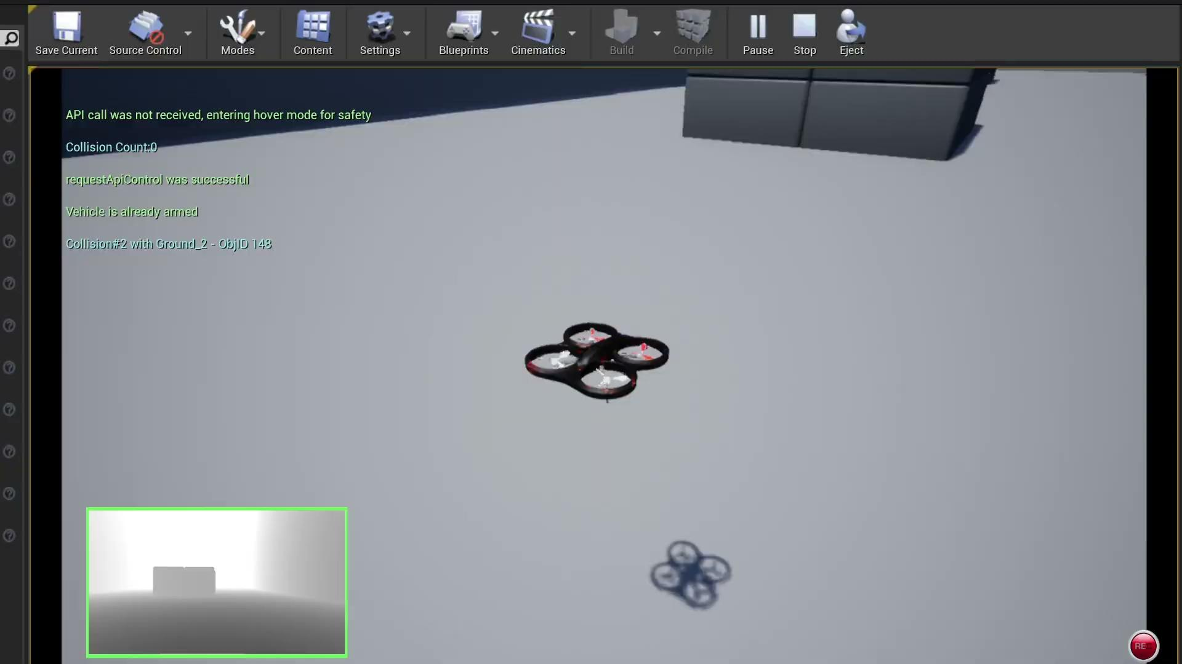
Results - Single Obstacle
Successful Task Completion - Single Obstacle

Slide 16
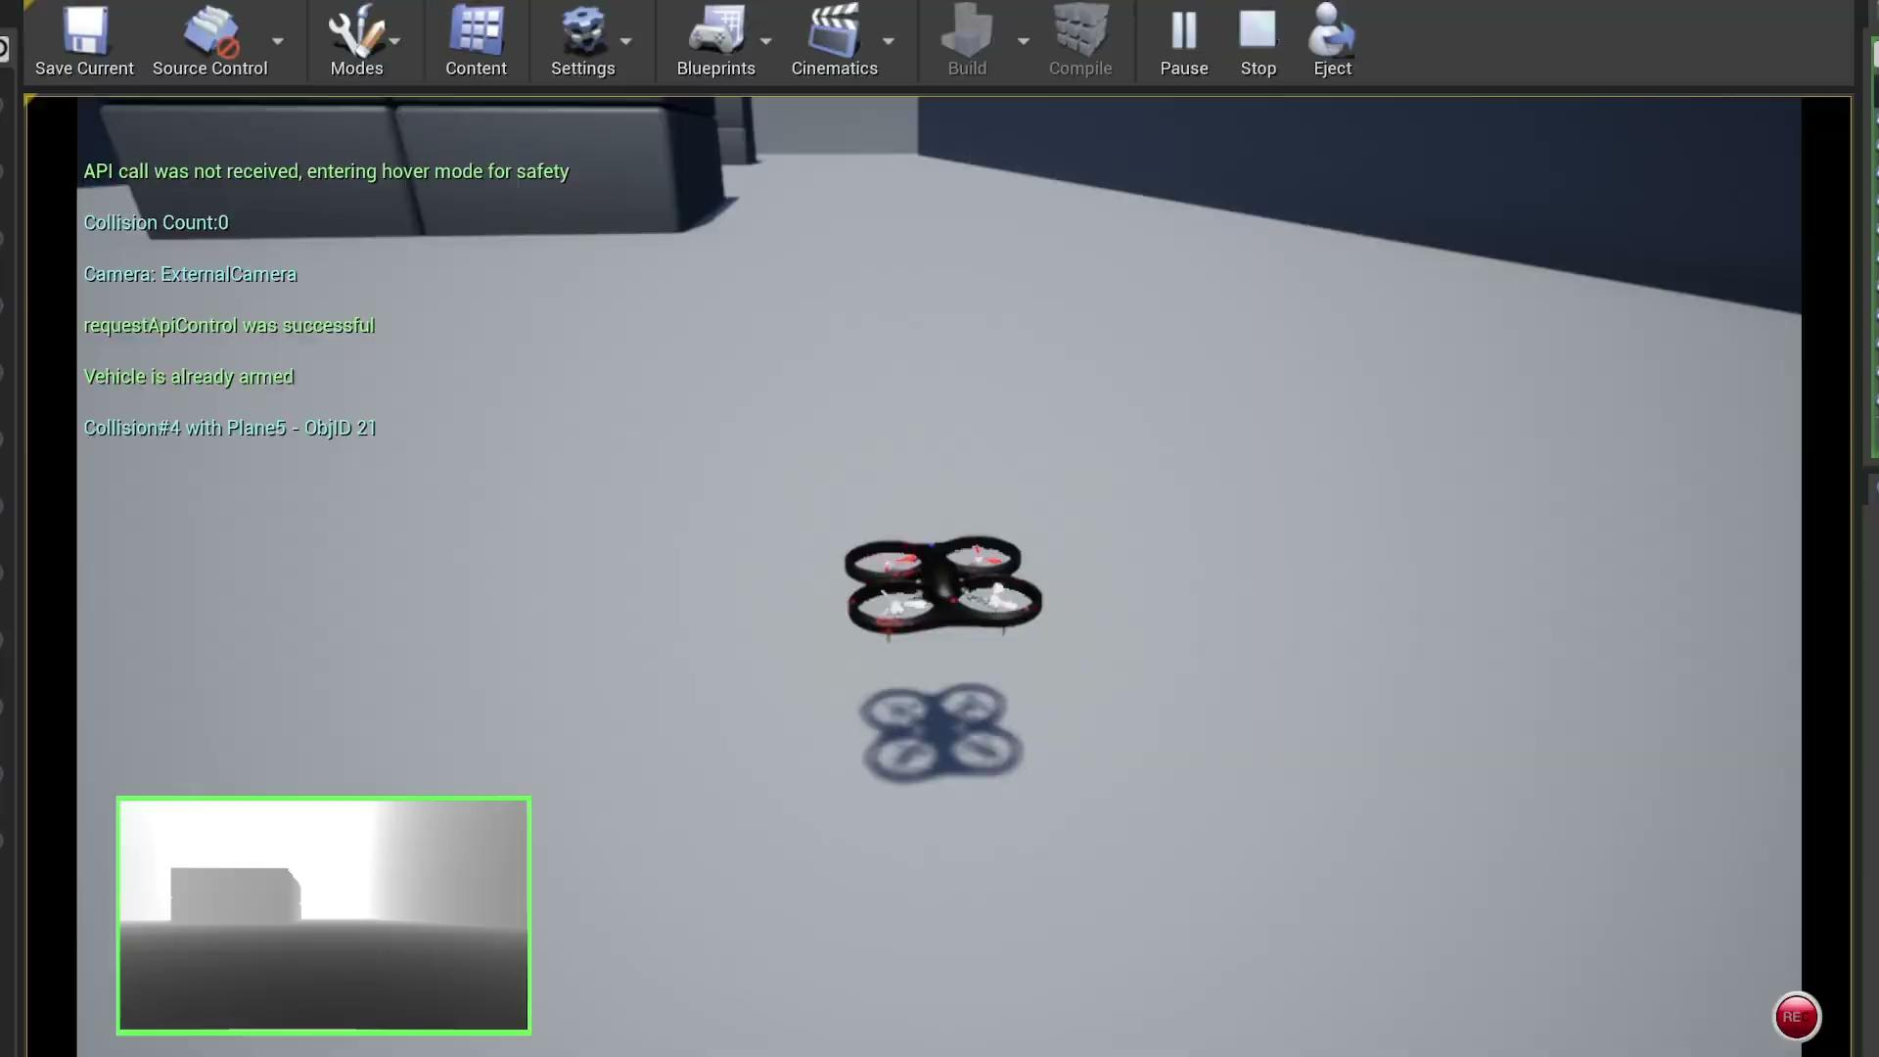
Results - Double Obstacle
Double Obstacle - Drift at the Second Obstacle
Further Training Iterations might resolve this

Slide 17
Challenges
The training involves a lot of hyperparameters which took time and we are not yet sure about their optimality.
The results were based on less number of iteration as experimenting different rewards and also equally training involved significant amount of compute and time which we were not able to afford.
We are limited to testing DQN only at this point because of time constraints. Further testing and experimenting with different Neural Network architectures such as Attention Models which can understand the relationship between Depth and the Relative position or any additional information for Nav would be helpful.

Slide 18
Conclusion
During our literature review we found QR-DQN ( Distributional Reinforcement Learning with Quantile Regression ) it is extension of DQN, it models the full distribution of the Q-values instead of just the expected value.
Better Uncertainty Estimation:
Improved Exploration
Robustness to Noise
Better Handling of Multi-modal Returns
During out experimentation we found that using motion primitive is a good idea compared to mapping the images to thrust vectors of drone. But if motion primitives are not well defined or doesn’t contain primitives for complex maneuvers drone might not be able to solve the navigation task.
It took a good amount of time, integrating Airsim and Unreal Engine in linux.

Slide 19
References
Distributional Reinforcement Learning with Quantile Regression Link: https://arxiv.org/abs/1710.10044
End-to-End Motion Planning of Quadrotors Using Deep Reinforcement Learning Link: https://arxiv.org/pdf/1909.13599
Stable Baseline 3 Documentation Link: https://github.com/DLR-RM/stable-baselines3/tree/master
Airsim Documentation Link: https://airsim-fork.readthedocs.io/en/docs/
Reinforcement Learning- second edition Richard S. Sutton and Andrew G. Barto Link: http://incompleteideas.net/book/RLbook2020.pdf

Slide 20
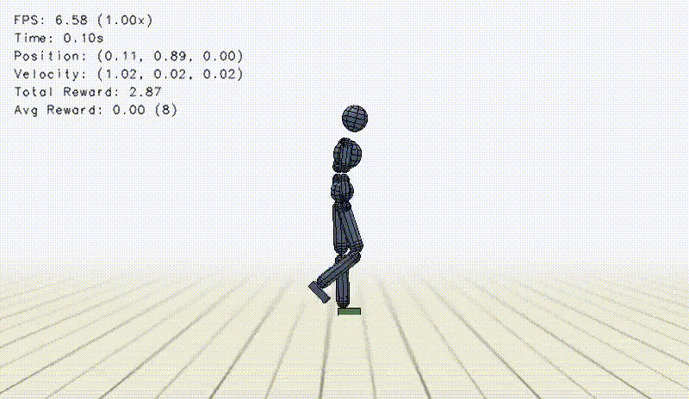
THANK YOU

